Slide 1
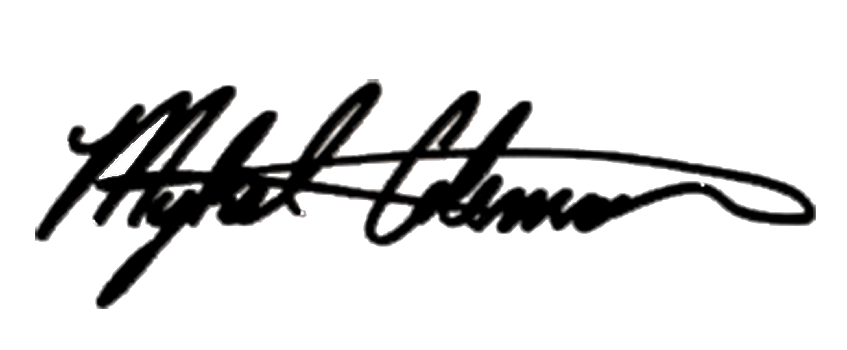
October 26, 2017
Dear Sponsor,
Mykel Coleman Studios (MCS) is performing a play entitled “You Better Not Tell” in support of a non-profit organization named Helping Kids to Recover, Inc. “You Better Not Tell” is a compelling play based on a true story that brings awareness to the growing problem of molestation, abuse and mental illness. The proceeds will go to Helping Kids to Recover, Inc. to continue counseling services.
According to the Justice Department, there are approximately four million pedophiles in the United States. It is difficult, however, to accurately assess the number of child molesters because many child molesters are not apprehended. The Justice Department reports the alarming statistic that one in four girls and one in seven boys will experience sexual abuse before the age of 18.
The intent of the play is to educate the community on how to identify molestation, report it and avail treatment for the victim (s). Please join Mykel Coleman Studios and Helping Kids to Recover, Inc. in their efforts in making a difference in the lives of victims and potential victims. Help us to make a difference in the lives of people who are silent and dealing with these circumstances to help bring awareness, educate and overcome.
Please complete the attached sponsorship form by selecting your level of participation and returning the form with your sponsorship to Mr. Mykel Coleman Studios 13360 Burbank Blvd. Suite # 1 Sherman Oaks, CA 91401.
Sincerely,
Mykel Coleman, President
Mykel Coleman Studios (MCS)

Slide 2
"YOU BETTER NOT TELL"
Musical Stage Play
based on a true story about abuse, molestation and mental illness
Sponsorship Package

Slide 3
"YOU BETTER NOT TELL"
Musical Stage Play
based on a true story about abuse, molestation and mental illness
Sponsorship Package
FRIDAY, DEC. 8TH @ 8PM DOORS OPEN AT 7PM
PARAMOUNT THEATRE
2025 BROADWAY OAKLAND, CA 94612
Watch the Trailer to Mykel Coleman presents
"YOU BETTER NOT TELL" Musical Stage Play based on a true story about abuse, molestation and mental illness to helping those who suffer from it!
https://youtu.be/Es28eJkZ3ko
TICKETS AVAILABLE @
TICKETMASTER.COM , EVENTBRITE.COM and
https://MYKELCOLEMANSTUDIOS.COM

Slide 4
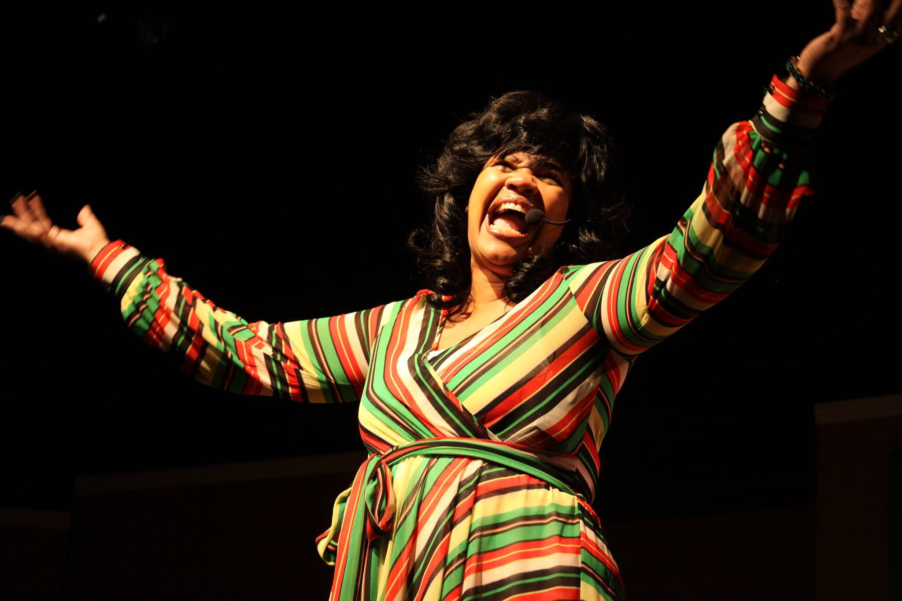
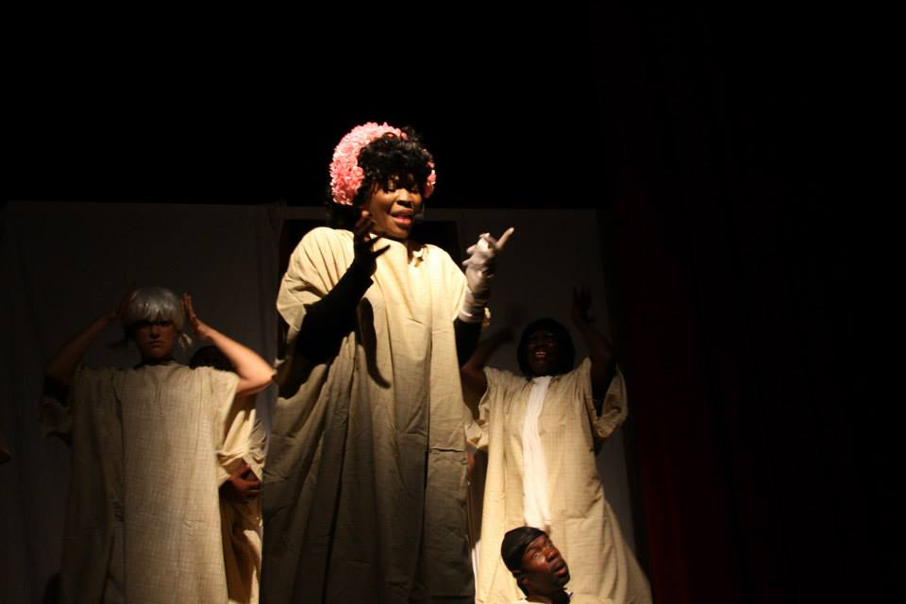
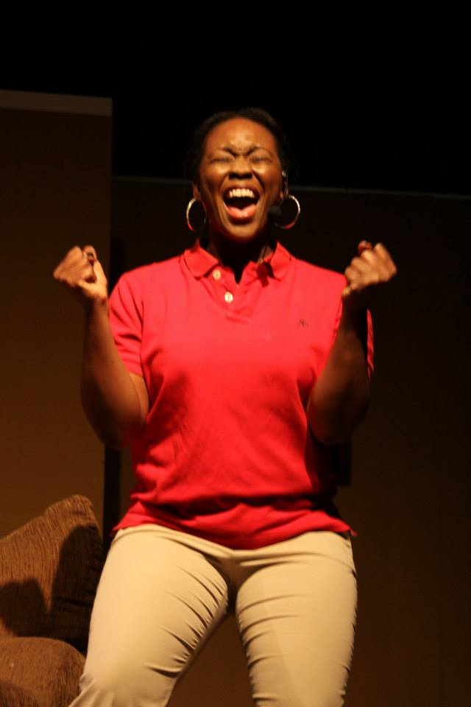
COMPELLING
UPLIFTING
REMARKABLE
CAPTIVATING
OVERCOMING

Slide 5
"YOU BETTER NOT TELL"
Musical Stage Play
based on a true story about abuse, molestation and mental illness
Sponsorship Package
Presenting Sponsor……….$25,000
Full page Ad in Commemorative program Book
(Inside Cover)
Recognized as our Presenting Sponsor in all
Marketing Piece
VIP Suite Access and Photo Opportunity with Celebrity master of Ceremonies
Twenty (20) Tickets to the play “You better Not Tell”
Platinum Sponsor…………..$20,000
Full page Ad in Commemorative Program Book
(Back Cover)
Recognized as a Platinum Sponsor in all
Marketing Pieces
Ten (10) Tickets to the play “You better Not Tell”
Gold Sponsor……………….$10,000
Half page Ad in Commemorative Program Book
Recognized as a Gold Sponsor in all Marketing Pieces
Eight (8) Tickets to the play “You better Not Tell”
Silver Sponsor……..……$5,000
Half page Ad in Commemorative Program Book
Recognized as a Silver Sponsor in all Marketing Pieces
Six (6) Tickets to the play “You better Not Tell”
Bronze Sponsor…….……$5,000
Quarter page Ad in Commemorative Program Book
Recognized as a Bronze Sponsor in all Marketing Pieces
Four (4) to the play “You Better Not Tell”
Friends of Helping Kids…$1,000
Recognition as a Friend of Helping Kids to Recover, Inc. in all marketing Pieces
Two (2) Tickets to the play “You Better Not Tell”

Slide 6
A Play based on A True Story
“You Better Not Tell”
November 19, 2017
SPONSOR COMMITMENT FORM
Yes! I/WE would like to Sponsor
The Compelling Play “You Better Not Tell”
$25,000 $20,000 $10,000 $5,000 $1,000 $_______other
Amount
Name/Company _____________________________________________________________________
Contact Person:______________________________________________________________________
Billing Address:______________________________________________________________________
City:__________________________________________State:________________ZIP:_____________
Phone:________________________________________Email:________________________________
PAYMENT
Enclosed is my/our check for the above indicated items in the amount of $__________
Please charge $___________to my Visa MasterCard American Express Discover
Name of Cardholder: _________________________________________________________
Credit Card #:______________________________________________________________
Signature: X_______________________________________________________________
Please make checks payable to: Mykel Coleman
13360 Burbank Blvd. Suite #1
Sherman Oaks, CA 91401
Please return this form to Mykel Coleman at the address above or email to mykelcolemanstudios@gmail.com
Should you have any questions or concern, please contact Mykel Coleman at (404) 951-4421

Slide 7
Watch the Trailer for
"YOU BETTER NOT TELL"
Musical Stage Play
based on a true story about abuse, molestation and mental illness
Double Click Image to Play Video
Presented by Director Mykel Coleman
VISIT: MYKELCOLEMANSTUDIOS.COM

Slide 8
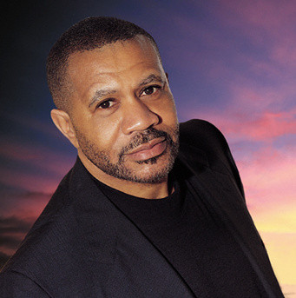
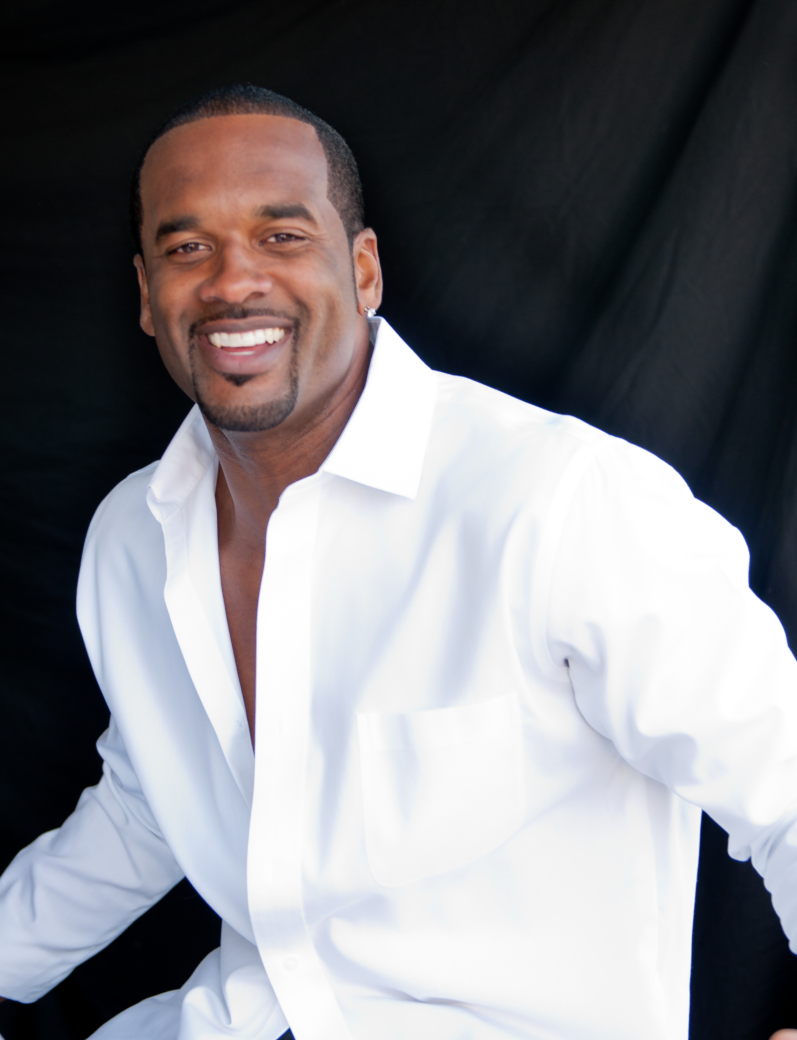
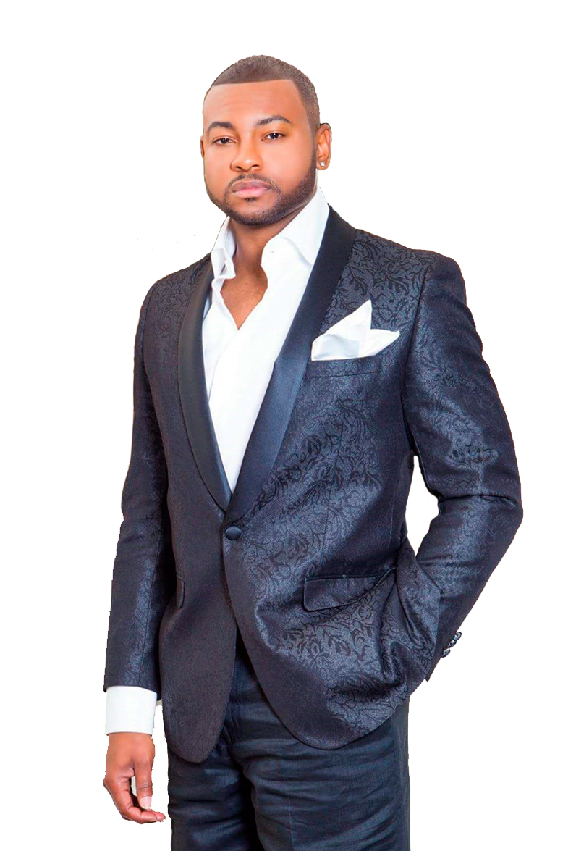
"YOU BETTER NOT TELL"
Musical Stage Play
based on a true story about abuse, molestation and mental illness
Sponsorship Package
Celebrity Cast Members
“Basketball Wives of LA” Jackie Christie
“R&B Singing Legend” Lenny Williams
“I Don’t Want to Do Wrong” Andre Pitre
“Writer and Director” Mykel Coleman

Slide 9
Board of Directors
Mykel Coleman
President/Director/Writer
Mykel Coleman Studios
13360 Burbank Blvd. Suite #1
Sherman Oaks, CA 91401
(404)951-4421
mykelcolemanstudios@gmail.com
Dwayne Sparks
Business Manager
(310) 562-2335
sparkseg@gmail.com
Patricia Lindsey, B.A.
Producer
plindsey07@gmail.com
Chynethia Boyd, M.B.A.
Producer
cboydhkr@yahoo.com

