Slide 1
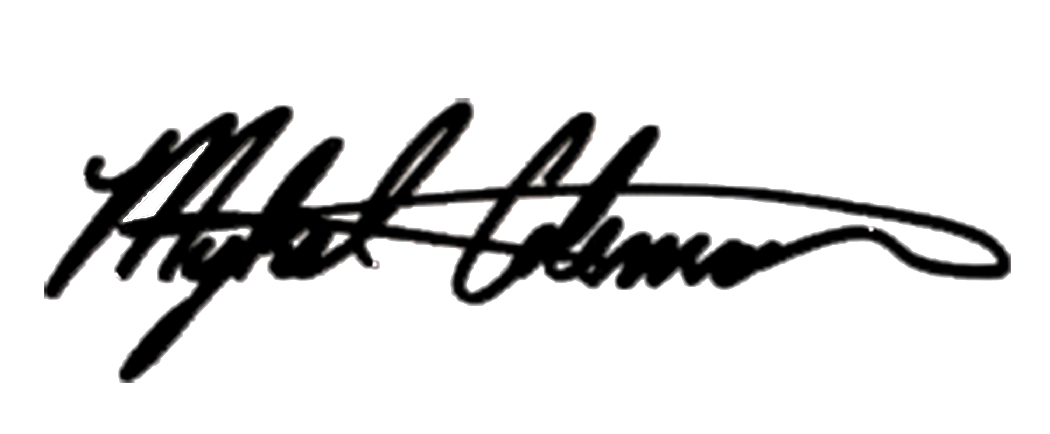
October 26, 2017
Dear Investor,
Mykel Coleman Studios (MCS) is performing a live stage play entitled “You Better Not Tell” in support of a non-profit organization named Helping Kids to Recover, Inc. Friday, December 8th @ 8pm at The Paramount Theatre in Oakland, CA!
“You Better Not Tell” is a compelling play based on a true story that brings awareness to the growing problem of molestation, abuse and mental illness. We are seeking a few investors who are interested in being part of this great cause. As an investor you will to earn between 10% to 20% on your investment.
The Stage Play will be held Friday, December 8th @ 8pm at The Paramount Theatre in Oakland, CA. You will receive you investment back plus the percentage based on your financial investment 7 days after the production is over which is estimated to be December 15th due to it takes the Paramount Theatre and Ticket Master this amount of time to process the accounting after the show production.
Your investment is guaranteed from Mykel Coleman Studios (MCS) and Sparks Entertainment. For investors who contribute 10,000 and above you can get your name mentioned on the end of the radio commercial.
Please complete the attached investor form by selecting your level of participation and returning the form with your sponsorship to Mr. Mykel Coleman Studios 13360 Burbank Blvd. Suite # 1 Sherman Oaks, CA 91401.
Sincerely,
Mykel Coleman, President
Mykel Coleman Studios (MCS)
Dwayne Sparks, President
Sparks Entertainment (SPE)

Slide 2
"YOU BETTER NOT TELL"
Musical Stage Play
based on a true story about abuse, molestation and mental illness
Small Investor Package
Gold Investor…….……$5,000 with a 20% return on investment
Half page Ad in Commemorative Program Book
Recognized as a Gold Partner in all Marketing Pieces listed in the Program Book
Four (6) to the play “You Better Not Tell”
Silver Investor…….……$2,500 with a 15% return on investment
Quarter page Ad in Commemorative Program Book
Recognized as a Silver Partner in all Marketing Pieces listed in the Program Book
Four (4) to the play “You Better Not Tell”
Bronze Investor…….……$1,000 with a 10% return on investment
Quarter page Ad in Commemorative Program Book
Recognized as a Bronze Partner in all Marketing Pieces listed in the Program Book
Four (2) to the play “You Better Not Tell”
Investor Chart
1,000 to 2,499 - Investor will receive 10% return on your investment
2,500 to 4,999 - Investor will receive 15% return on your investment
5,000 and above - Investor will receive 20% return on your investment

Slide 3
A Play based on A True Story
“You Better Not Tell”
December 8, 2017
INVESTOR COMMITMENT FORM
Yes! I/WE would like to Invest
The Compelling Play “You Better Not Tell”
$10,000 $5,000 $2,500 $1,500 $1,000
Enter you Amount Here After you Check the Appropriate Box of Investment $_________ with the percentage return on the investment based on the chart listed ________ %.
Name/Company _____________________________________________________________________
Contact Person:_____________________________________________________________________
Billing Address:____________________________________________________________________
City:__________________________________________State:________________ZIP:_____________
Phone:________________________________________Email:________________________
CREDIT CARD PAYMENT
Enclosed is my/our check for the above indicated items in the amount of $__________
Please charge $___________to my Visa MasterCard American Express Discover
Name of Cardholder: _________________________________________________________
Credit Card #:______________________________________________________________
Signature: X_______________________________________________________________
Please make investment via paypal or online at:
https://MykelColemanStudios.com
Click the Partnership Button
Should you have any questions or concern, please contact:
Mykel Coleman of Mykel Coleman Studios at (404) 951-4421 or
Dwayne Sparks of Sparks Entertainment at (310)562-2335

Slide 4
"YOU BETTER NOT TELL"
Musical Stage Play
based on a true story about abuse, molestation and mental illness
Investor Package
FRIDAY, DEC. 8TH @ 8PM DOORS OPEN AT 7PM
PARAMOUNT THEATRE
2025 BROADWAY OAKLAND, CA 94612
Watch the Trailer to Mykel Coleman presents
"YOU BETTER NOT TELL" Musical Stage Play based on a true story about abuse, molestation and mental illness to helping those who suffer from it!
https://youtu.be/Es28eJkZ3ko
TICKETS AVAILABLE @
TICKETMASTER.COM , EVENTBRITE.COM and
https://MYKELCOLEMANSTUDIOS.COM

Slide 5
"YOU BETTER NOT TELL"
Musical Stage Play
based on a true story about abuse, molestation and mental illness
Investor Package

Slide 6
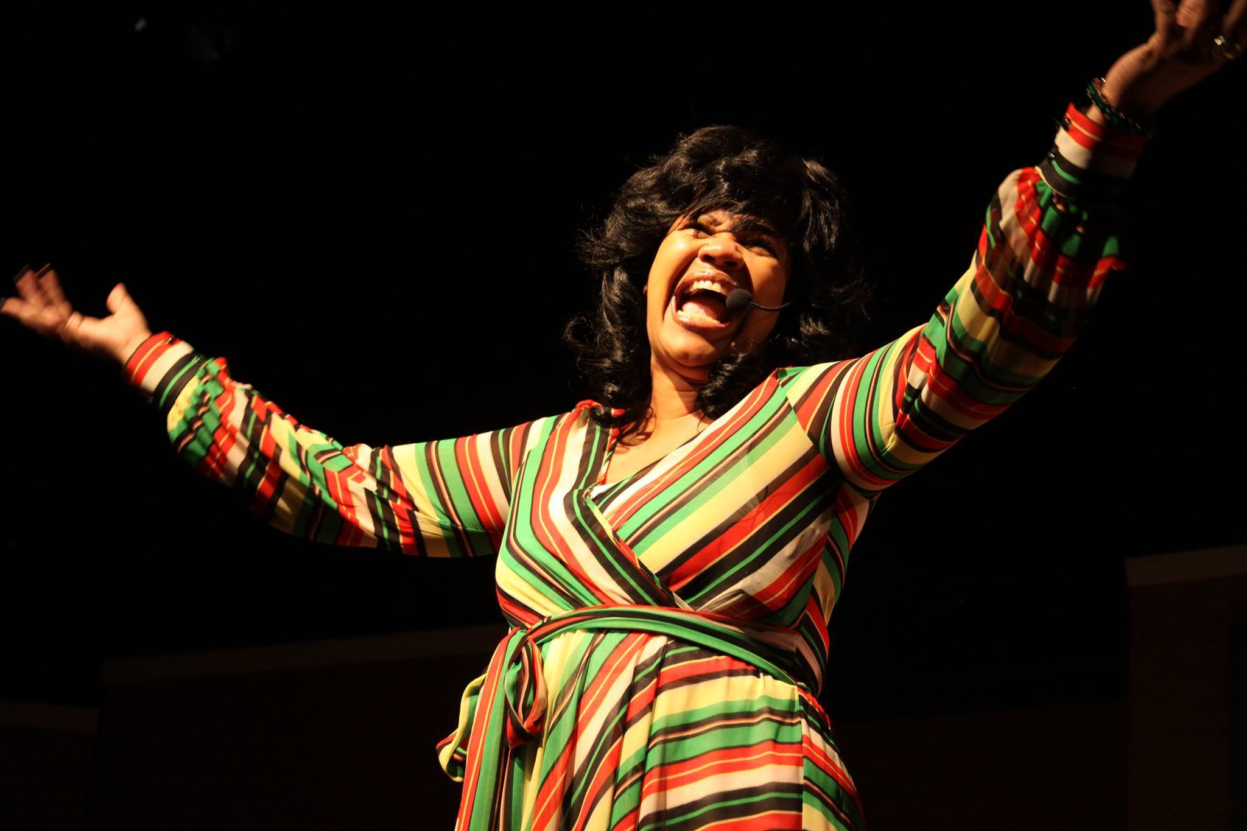
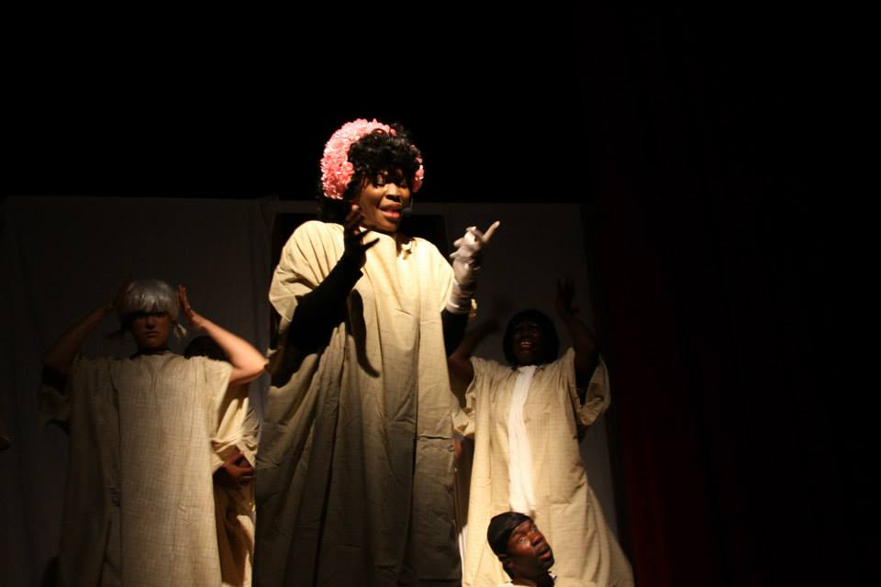
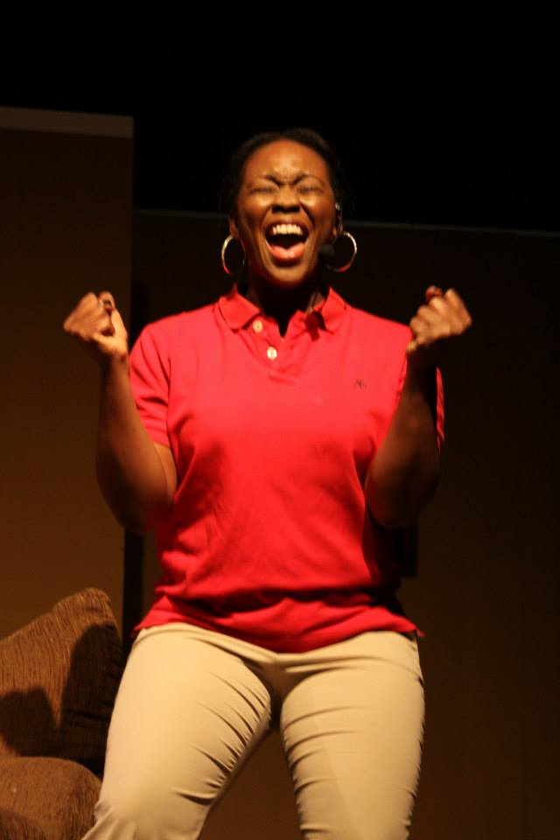
COMPELLING
UPLIFTING
REMARKABLE
CAPTIVATING
OVERCOMING

Slide 7
Watch the Trailer for
"YOU BETTER NOT TELL"
Musical Stage Play
based on a true story about abuse, molestation and mental illness
Double Click Image to Play Video
Presented by Director Mykel Coleman
VISIT: MYKELCOLEMANSTUDIOS.COM

Slide 8
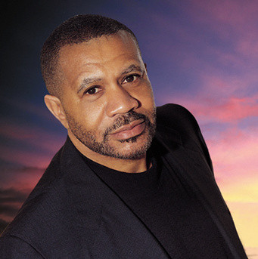
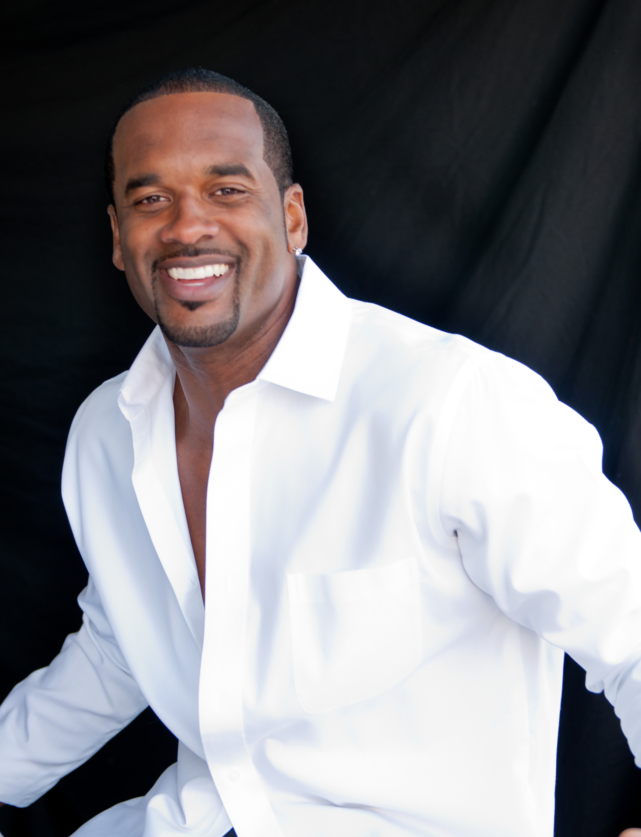
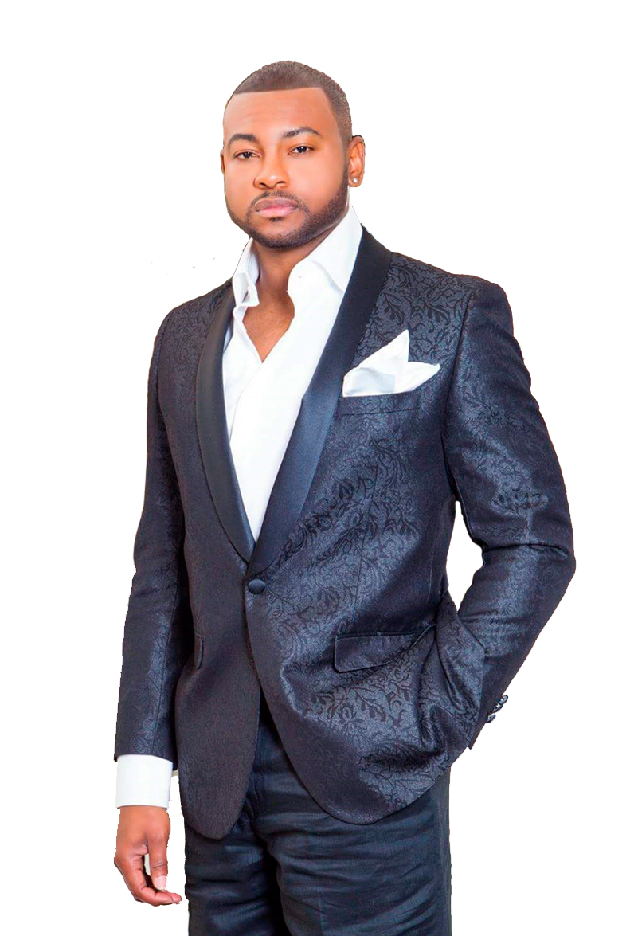
"YOU BETTER NOT TELL"
Musical Stage Play
based on a true story about abuse, molestation and mental illness
Investor Package
Celebrity Cast Members
“Basketball Wives of LA” Jackie Christie
“R&B Singing Legend” Lenny Williams
“I Don’t Want to Do Wrong” Andre Pitre
“Writer and Director” Mykel Coleman

Slide 9
Board of Directors
Mykel Coleman
President/Director/Writer
Mykel Coleman Studios
13360 Burbank Blvd. Suite #1
Sherman Oaks, CA 91401
(404)951-4421
mykelcolemanstudios@gmail.com
Dwayne Sparks
Business Manager
(310) 562-2335
sparkseg@gmail.com
Patricia Lindsey, B.A.
Producer
plindsey07@gmail.com
Chynethia Boyd, M.B.A.
Producer
cboydhkr@yahoo.com

